Slide 1
SSL / TLS Case Study
CS 395T

Slide 2
Overview
Introduction to the SSL / TLS protocol
  Widely deployed, “real-world” security protocol
Protocol analysis case study
  Start with the RFC describing the protocol
  Create an abstract model and code it up in Mur
  Specify security properties
  Run Mur to check whether security properties are satisfied
This lecture is a compressed version of what you will be doing in your project!

Slide 3
What is SSL / TLS?
Transport Layer Security protocol, version 1.0
  De facto standard for Internet security
  “The primary goal of the TLS protocol is to provide privacy and data integrity between two communicating applications”
  In practice, used to protect information transmitted between browsers and Web servers
Based on Secure Sockets Layers protocol, ver 3.0
  Same protocol design, different algorithms
Deployed in nearly every Web browser

Slide 4
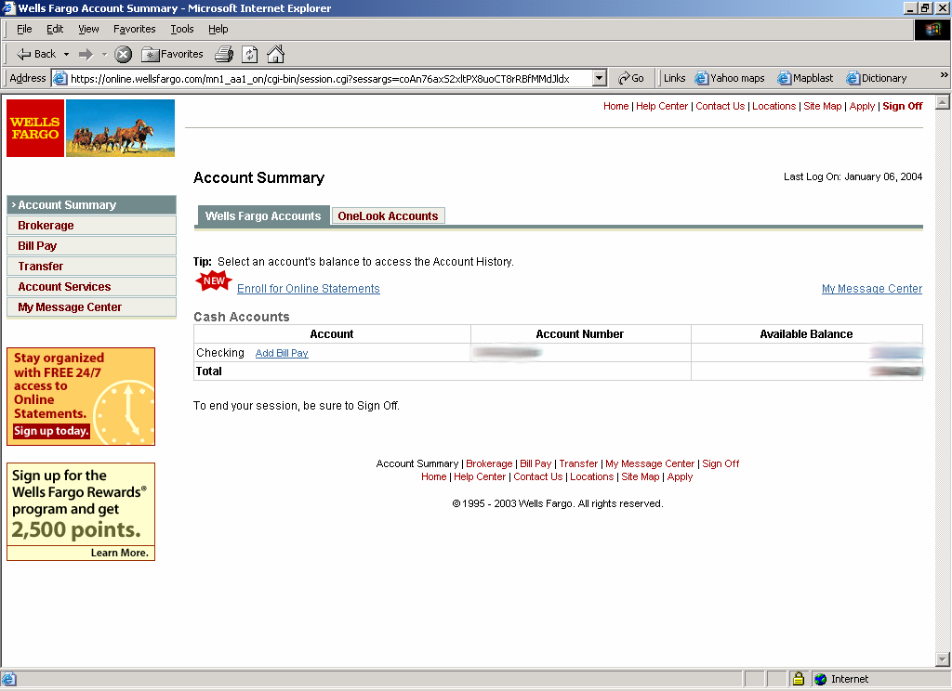
SSL / TLS in the Real World

Slide 5
History of the Protocol
SSL 1.0
  Internal Netscape design, early 1994?
  Lost in the mists of time
SSL 2.0
  Published by Netscape, November 1994
  Several weaknesses
SSL 3.0
  Designed by Netscape and Paul Kocher, November 1996
TLS 1.0
  Internet standard based on SSL 3.0, January 1999
  Not interoperable with SSL 3.0
    TLS uses HMAC instead of MAC; can run on any port…

Slide 6
Let’s Get Going…
Informal
protocol
description
Formal
specification
Intruder
model
RFC
(request for
comments)
Analysis
tool
Find error

Slide 7
Request for Comments
Network protocols are usually disseminated in the form of an RFC
TLS version 1.0 is described in RFC 2246
Intended to be a self-contained definition of the protocol
  Describes the protocol in sufficient detail for readers who will be implementing it and those who will be doing protocol analysis (that’s you!)
  Mixture of informal prose and pseudo-code
Read some RFCs to get a flavor of what protocols look like when they emerge from the committee

Slide 8
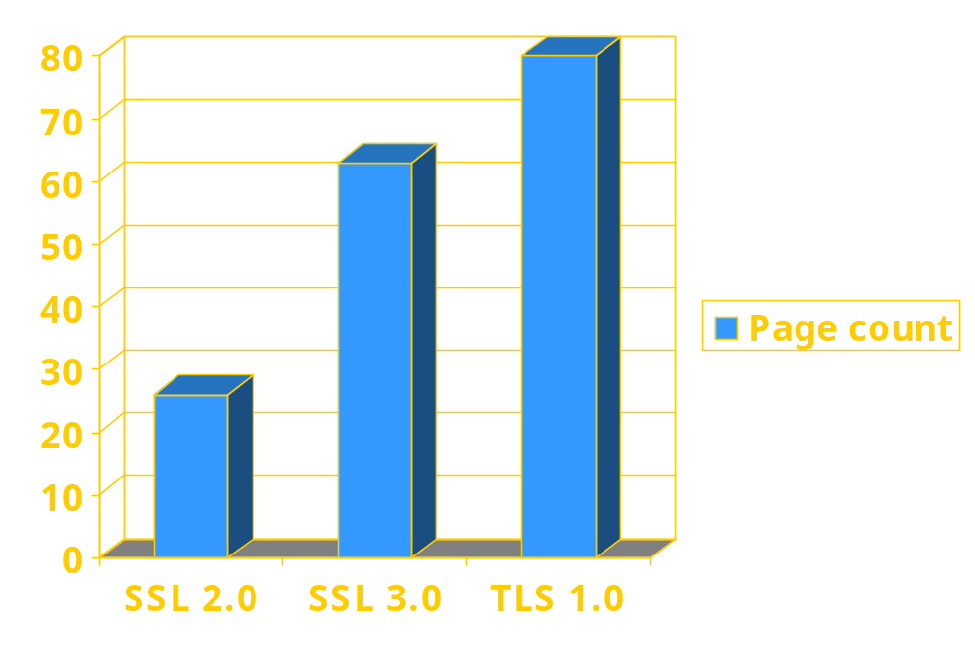
Evolution of the SSL/TLS RFC

Slide 9
From RFC to Murϕ Model
Informal
protocol
description
Formal
specification
Intruder
model
RFC
(request for
comments)
Murϕ code
Analysis
Tool
Find error

Slide 10
TLS Basics
TLS consists of two protocols
Handshake protocol
  Use public-key cryptography to establish a shared secret key between the client and the server
Record protocol
  Use the secret key established in the handshake protocol to protect communication between the client and the server
We will focus on the handshake protocol

Slide 11
TLS Handshake Protocol
Two parties: client and server
Negotiate version of the protocol and the set of cryptographic algorithms to be used
  Interoperability between different implementations of the protocol
Authenticate client and server (optional)
  Use digital certificates to learn each other’s public keys and verify each other’s identity
Use public keys to establish a shared secret

Slide 12
Handshake Protocol Structure
ClientHello
S
C
ServerHello,
[Certificate],
[ServerKeyExchange],
[CertificateRequest],
ServerHelloDone
[Certificate],
ClientKeyExchange,
[CertificateVerify]
Finished
switch to negotiated cipher
switch to negotiated cipher
Finished

Slide 13
Abbreviated Handshake
The handshake protocol may be executed in an abbreviated form to resume a previously established session
  No authentication, key material not exchanged
  Session resumed from an old state
For complete analysis, have to model both full and abbreviated handshake protocol
  This is a common situation: many protocols have several branches, subprotocols for error handling, etc.

Slide 14
Rational Reconstruction
Begin with simple, intuitive protocol
  Ignore client authentication
  Ignore verification messages at the end of the handshake protocol
  Model only essential parts of messages (e.g., ignore padding)
Execute the model checker and find a bug
Add a piece of TLS to fix the bug and repeat
  Better understand the design of the protocol

Slide 15
Protocol Step by Step: ClientHello
ClientHello
S
C
Client announces (in plaintext):
Protocol version he is running
Cryptographic algorithms he supports

Slide 16
ClientHello (RFC)
struct {
ProtocolVersion client_version;
Random random;
SessionID session_id;
CipherSuite cipher_suites;
CompressionMethod compression_methods;
} ClientHello
Highest version of the protocol supported by the client
Session id (if the client wants to resume an old session)
Cryptographic algorithms supported by the client (e.g., RSA or Diffie-Hellman)

Slide 17
ClientHello (Mur)
ruleset i: ClientId do
ruleset j: ServerId do
rule "Client sends ClientHello to server (new session)"
cli[i].state = M_SLEEP &
cli[i].resumeSession = false
==>
var
outM: Message; -- outgoing message
begin
outM.source := i;
outM.dest := j;
outM.session := 0;
outM.mType := M_CLIENT_HELLO;
outM.version := cli[i].version;
outM.suite := cli[i].suite;
outM.random := freshNonce();
multisetadd (outM, cliNet);
cli[i].state := M_SERVER_HELLO;
end;
end;
end;

Slide 18
ServerHello
C, Version_{c}, suite_{c}, N_{c}
S
C
ServerHello
Server responds (in plaintext) with:
Highest protocol version both client &
server support
Strongest cryptographic suite selected
from those offered by the client

Slide 19
ServerHello (Mur)
ruleset i: ServerId do
choose l: serNet do
rule “Server receives ServerHello (new session)"
ser[i].clients[0].state = M_CLIENT_HELLO &
serNet[l].dest = i &
serNet[l].session = 0
==>
var
inM: Message; -- incoming message
outM: Message; -- outgoing message
begin
inM := serNet[l]; -- receive message
if inM.mType = M_CLIENT_HELLO then
outM.source := i;
outM.dest := inM.source;
outM.session := freshSessionId();
outM.mType := M_SERVER_HELLO;
outM.version := ser[i].version;
outM.suite := ser[i].suite;
outM.random := freshNonce();
multisetadd (outM, serNet);
ser[i].state := M_SERVER_SEND_KEY;
end; end; end;

Slide 20
ServerKeyExchange
C, Version_{c}, suite_{c}, N_{c}
S
C
Version_{s}, suite_{s}, N_{s},
ServerKeyExchange
Server send his public-key certificate
containing either his RSA, or
his Diffie-Hellman public key
(depending on chosen crypto suite)

Slide 21
“Abstract” Cryptography
We will use abstract data types to model cryptographic operations
  Assumes that cryptography is perfect
  No details of the actual cryptographic schemes
  Ignores bit length of keys, random numbers, etc.
Simple notation for encryption, signatures, hashes
  {M}_{k} is message M encrypted with key k
  sig_{k}(M) is message M digitally signed with key k
  hash(M) for the result of hashing message M with a cryptographically strong hash function

Slide 22
ClientKeyExchange
C, Version_{c}, suite_{c}, N_{c}
S
C
Version_{s}, suite_{s}, N_{s},
sig_{ca}(S,K_{s}),
“ServerHelloDone”
ClientKeyExchange
Client generates some secret key material
and sends it to the server encrypted with
the server’s public key

Slide 23
ClientKeyExchange (RFC)
struct {
select (KeyExchangeAlgorithm) {
case rsa: EncryptedPreMasterSecret;
case diffie_hellman: ClientDiffieHellmanPublic;
} exchange_keys
} ClientKeyExchange
struct {
ProtocolVersion client_version;
opaque random[46];
} PreMasterSecret
Let’s model this as {Secret_{c}}_{Ks}

Slide 24
“Core” TLS
C, Version_{c}, suite_{c}, N_{c}
S
C
Version_{s}, suite_{s}, N_{s},
sig_{ca}(S,K_{s}),
“ServerHelloDone”
{Secret_{c}}_{Ks}
If the protocol is correct, C and S share
some secret key material (secret_{c}) at this point
switch to key derived
from secret_{c}
switch to key derived
from secret_{c}

Slide 25
Participants as Finite-State Machines
Mur rules define a finite-state machine for each protocol participant
Client state
Server state
ClientHello
M_SLEEP
M_CLIENT_HELLO
ServerHello
M_SERVER_HELLO
M_SEND_KEY
ServerKeyExchange
M_SERVER_KEY
M_CLIENT_KEY
M_SEND_KEY
M_DONE
ClientKeyExchange

Slide 26
Intruder Model
Informal
protocol
description
Formal
specification
Intruder
model
RFC
(request for
comments)
Murϕ code
Murϕ code,
similar for
all protocols
Analysis
tool
Find error

Slide 27
Intruder Can Intercept
Store a message from the network in the data structure modeling intruder’s “knowledge”
ruleset i: IntruderId do
choose l: cliNet do
rule "Intruder intercepts client's message"
cliNet[l].fromIntruder = false
==>
begin
alias msg: cliNet[l] do -- message from the net
…
alias known: int[i].messages do
if multisetcount(m: known,
msgEqual(known[m], msg)) = 0 then
multisetadd(msg, known);
end;
end;
end;

Slide 28
Intruder Can Decrypt if Knows Key
If the key is stored in the data structure modeling intruder’s “knowledge”, then read message
ruleset i: IntruderId do
choose l: cliNet do
rule "Intruder intercepts client's message"
cliNet[l].fromIntruder = false
==>
begin
alias msg: cliNet[l] do -- message from the net
…
if msg.mType = M_CLIENT_KEY_EXCHANGE then
if keyEqual(msg.encKey, int[i].publicKey.key) then
alias sKeys: int[i].secretKeys do
if multisetcount(s: sKeys,
keyEqual(sKeys[s], msg.secretKey)) = 0 then
multisetadd(msg.secretKey, sKeys);
end;
end;
end;

Slide 29
Intruder Can Create New Messages
Assemble pieces stored in the intruder’s “knowledge” to form a message of the right format
ruleset i: IntruderId do
ruleset d: ClientId do
ruleset s: ValidSessionId do
choose n: int[i].nonces do
ruleset version: Versions do
rule "Intruder generates fake ServerHello"
cli[d].state = M_SERVER_HELLO
==>
var
outM: Message; -- outgoing message
begin
outM.source := i; outM.dest := d; outM.session := s;
outM.mType := M_SERVER_HELLO;
outM.version := version;
outM.random := int[i].nonces[n];
multisetadd (outM, cliNet);
end; end; end; end;

Slide 30
Intruder Model and Cryptography
There is no actual cryptography in this model
  Messages are marked as “encrypted” or “signed”, and the intruder rules respect these markers
The assumption that cryptography is perfect is reflected by the absence of certain intruder rules
  There is no rule for creating a digital signature with a key that is not known to the intruder
  There is no rule for reading the contents of a message which is marked as “encrypted” with a certain key, when this key is not known to the intruder
  There is no rule for reading the contents of a “hashed” message

Slide 31
Running Murϕ Analysis
Informal
protocol
description
Formal
specification
Intruder
model
RFC
(request for
comments)
Murϕ code
Murϕ code,
similar for
all protocols
Analysis
tool
Find error
Specify security conditions
and run Murϕ

Slide 32
Secrecy
Intruder should not be able to learn the secret generated by the client
ruleset i: ClientId do
ruleset j: IntruderId do
rule "Intruder has learned a client's secret"
cli[i].state = M_DONE &
multisetcount(s: int[j].secretKeys,
keyEqual(int[j].secretKeys[s], cli[i].secretKey)) > 0
==>
begin
error "Intruder has learned a client's secret"
end;
end;
end;

Slide 33
Shared Secret Consistency
After the protocol has finished, client and server should agree on their shared secret
ruleset i: ServerId do
ruleset s: SessionId do
rule "Server's shared secret is not the same as its client's"
ismember(ser[i].clients[s].client, ClientId) &
ser[i].clients[s].state = M_DONE &
cli[ser[i].clients[s].client].state = M_DONE &
!keyEqual(cli[ser[i].clients[s].client].secretKey,
ser[i].clients[s].secretKey)
==>
begin
error "S's secret is not the same as C's"
end;
end;
end;

Slide 34
Version and Crypto Suite Consistency
Client and server should be running the highest version of the protocol they both support
ruleset i: ServerId do
ruleset s: SessionId do
rule "Server has not learned the client's version or suite correctly"
!ismember(ser[i].clients[s].client, IntruderId) &
ser[i].clients[s].state = M_DONE &
cli[ser[i].clients[s].client].state = M_DONE &
(ser[i].clients[s].clientVersion != MaxVersion |
ser[i].clients[s].clientSuite.text != 0)
==>
begin
error "Server has not learned the client's version or suite correctly"
end;
end;
end;

Slide 35
Finite-State Verification
Mur rules for protocol participants and the intruder define a nondeterministic state transition graph
Mur will exhaustively enumerate all graph nodes
Mur will verify whether specified security conditions hold in every reachable node
If not, the path to the violating node will describe the attack
...
...
Correctness
condition violated

Slide 36
When Does Mur Find a Violation?
Bad abstraction
  Removed too much detail from the protocol when constructing the abstract model
  Add the piece that fixes the bug and repeat
  This is part of the rational reconstruction process
Genuine attack
  Yay! Hooray!
  Attacks found by formal analysis are usually quite strong: independent of specific cryptographic schemes, OS implementation, etc.
  Test an implementation of the protocol, if available

Slide 37
“Core” SSL 3.0
C, Version_{c}=3.0, suite_{c}, N_{c}
S
C
Version_{s}=3.0, suite_{s}, N_{s},
sig_{ca}(S,K_{s}),
“ServerHelloDone”
{Secret_{c}}_{Ks}
If the protocol is correct, C and S share
some secret key material (secret_{c}) at this point
switch to key derived
from secret_{c}
switch to key derived
from secret_{c}

Slide 38
Version Consistency Fails!
C, Version_{c}=2.0, suite_{c}, N_{c}
S
C
Server is fooled into thinking he is communicating with a client who supports only SSL 2.0
Version_{s}=2.0, suite_{s}, N_{s},
sig_{ca}(S,K_{s}),
“ServerHelloDone”
{Secret_{c}}_{Ks}
C and S end up communicating using SSL 2.0
(weaker earlier version of the protocol)

Slide 39
A Case of Bad Abstraction
struct {
select (KeyExchangeAlgorithm) {
case rsa: EncryptedPreMasterSecret;
case diffie_hellman: ClientDiffieHellmanPublic;
} exchange_keys
} ClientKeyExchange
struct {
ProtocolVersion client_version;
opaque random[46];
} PreMasterSecret
Model this as {Version_{c}, Secret_{c}}_{Ks}
This piece matters! Need to add it to the model.

Slide 40
Fixed “Core” SSL 3.0
C, Version_{c}=3.0, suite_{c}, N_{c}
S
C
Version_{s}=3.0, suite_{s}, N_{s},
sig_{ca}(S,K_{s}),
“ServerHelloDone”
Prevents version
rollback attack
Add rule to check that received version is equal to version in ClientHello
{Version_{c},Secret_{c}}_{Ks}
If the protocol is correct, C and S share
some secret key material secret_{c} at this point
switch to key derived
from secret_{c}
switch to key derived
from secret_{c}

Slide 41
SSL 2.0 Weaknesses (Fixed in 3.0)
Cipher suite preferences are not authenticated
  “Cipher suite rollback” attack is possible
Weak MAC construction
SSL 2.0 uses padding when computing MAC in block cipher modes, but padding length field is not authenticated
  Attacker can delete bytes from the end of messages
MAC hash uses only 40 bits in export mode
No support for certificate chains or non-RSA algorithms, no handshake while session is open

Slide 42
Basic Pattern for Doing Your Project
Read and understand protocol specification
  Typically an RFC or a research paper
  Website has some protocol specs, I’ll put up more
Choose a tool
  Mur by default, but I’ll describe many other tools
  Play with Mur now to get some experience (installing, running simple models, etc.)
Start with a simple (possibly flawed) model
  Rational reconstruction is a good way to go
Give careful thought to security conditions

Slide 43
Background Reading on SSL 3.0
Optional, for deeper understanding of SSL / TLS
D. Wagner and B. Schneier. “Analysis of the SSL 3.0 protocol.” USENIX Electronic Commerce ’96.
  Nice study of an early proposal for SSL 3.0
J.C. Mitchell, V. Shmatikov, U. Stern. “Finite-State Analysis of SSL 3.0”. USENIX Security ’98.
  Murϕ analysis of SSL 3.0 (similar to this lecture)
  Actual Murϕ model is in /projects/shmat/Murphi3.1/ex/secur
D. Bleichenbacher. “Chosen Ciphertext Attacks against Protocols Based on RSA Encryption Standard PKCS #1”. CRYPTO ’98.
  Cryptography is not perfect: this paper breaks SSL 3.0 by directly attacking underlying implementation of RSA

